Slide 1
Table and Lists

Slide 2
Objectives
Table
Unordered list
Ordered list

Slide 3
HTML Tables and Lists
Tables
Number | First Name | Last Name | Points
1 | Eve | Jackson | 94
2 | John | Doe | 80
3 | Adam | Johnson | 67

Slide 4
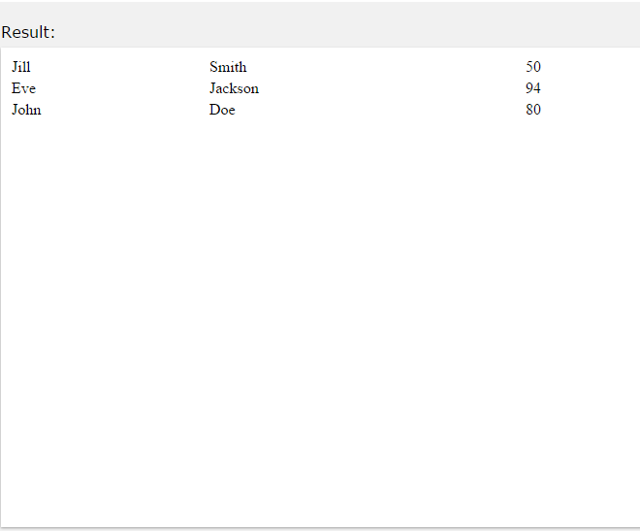
Defining HTML Tables
Example
<table style="width:100%">
<tr>
<td>Jill</td>
<td>Smith</td>
<td>50</td>
</tr>
<tr>
<td>Eve</td>
<td>Jackson</td>
<td>94</td>
</tr>
</table>

Slide 5
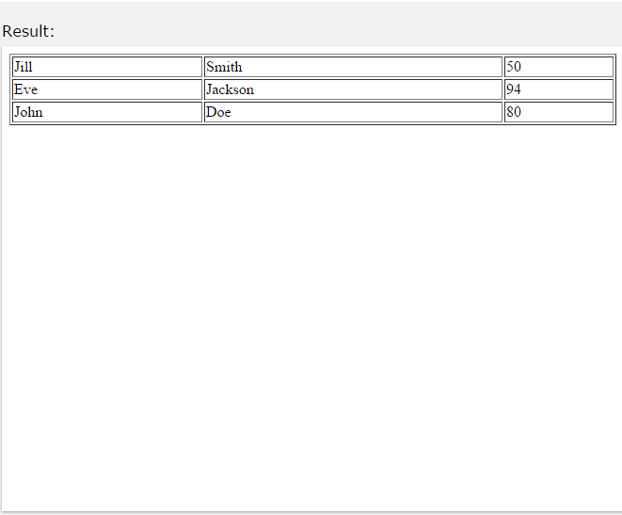
Border Attribute
If you do not specify a border for the table, it will be displayed without borders.
<table border="1" style="width:100%">
<tr>
<td>Jill</td>
<td>Smith</td>
<td>50</td>
</tr>
<tr>
<td>Eve</td>
<td>Jackson</td>
<td>94</td>
</tr>
</table>

Slide 6
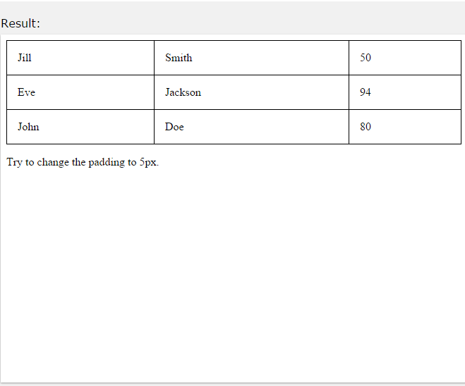
Cell Padding
Cell padding specifies the space between the cell content and its borders.
If you do not specify a padding, the table cells will be displayed without padding.
To set the padding, use the CSS padding property:
table, th, td {
border: 1px solid black; border-collapse: collapse;
}
th, td {
padding: 15px;
}

Slide 7
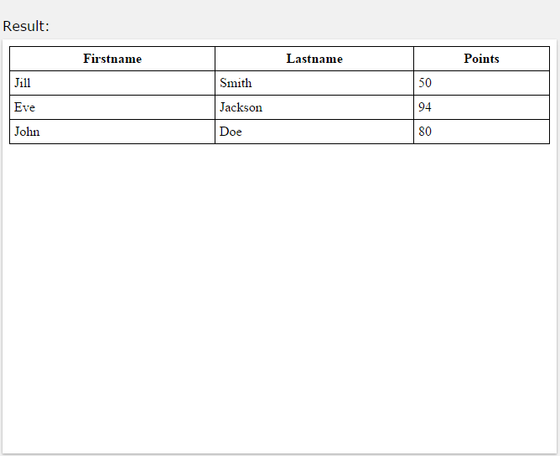
HTML Table Headings
Table headings are defined with the <th> tag.
By default, all major browsers display table headings as bold and centered:
<table style="width:100%">
<tr>
<th>Firstname</th>
<th>Lastname</th>
<th>Points</th>
</tr>
<tr>
<td>Eve</td>
<td>Jackson</td>
<td>94</td>
</tr>
</table>

Slide 8
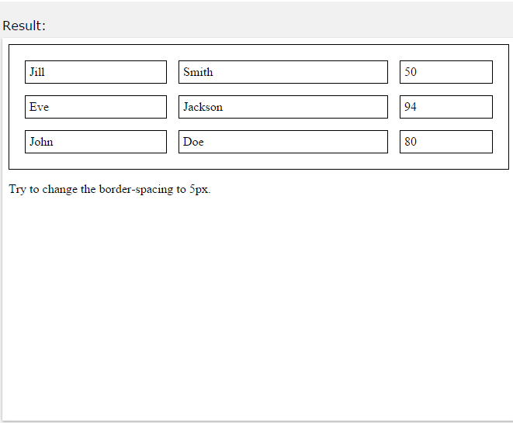
Border Spacing
Border spacing specifies the space between the cells.
To set the border spacing for a table, use the CSS border- spacing property:
Example
table {
border-spacing: 5px;
}

Slide 9
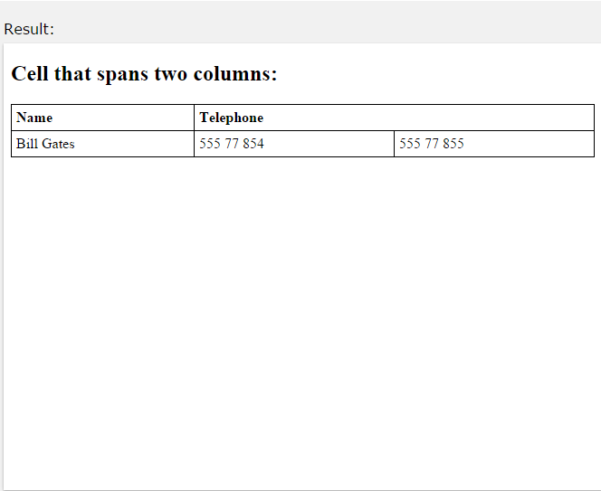
Table Cells that Span Many Columns
To make a cell span more than one
column, use
the colspan attribute:
<table style="width:100%">
<tr>
<th>Name</th>
<th colspan="2">Telephone</th>
</tr>
<tr>
<td>Bill Gates</td>
<td>555 77 854</td>
<td>555 77 855</td>
</tr>
</table>

Slide 10
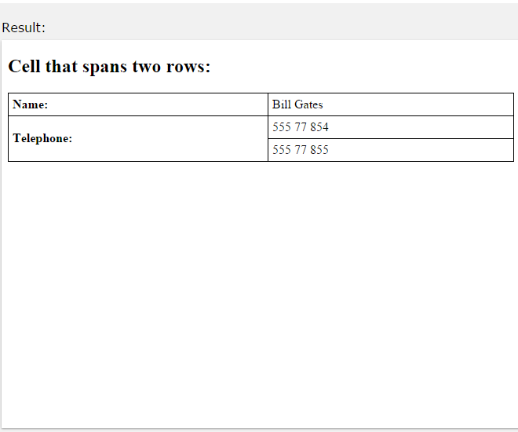
Table Cells that Span Many Rows
To make a cell span more
than
one row, use
the rowspan attribute: Example
<table style="width:100%">
<tr>
<th>Name:</th>
<td>Bill Gates</td>
</tr>
<tr>
<th rowspan="2">Telephone:</th>
<td>555 77 854</td>
</tr>
<tr>
<td>555 77 855</td>
</tr>
</table>

Slide 11
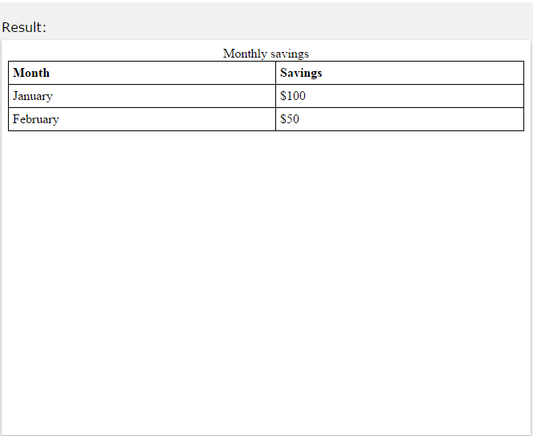
An HTML Table With a Caption
To add a caption to a table, use the <caption> tag:
Example
<table style="width:100%">
<caption>Monthly savings</caption>
<tr>
<th>Month</th>
<th>Savings</th>
</tr>
<tr>
<td>January</td>
<td>$100</td>

Slide 12

HTML Lists
Unordered HTML Lists
An unordered list starts with the <ul> tag. Each list item starts with the <li> tag.
The list items will be marked with bullets (small black circles): Example
<ul>
<li>Coffee</li>
<li>Tea</li>
<li>Milk</li>
</ul>

Slide 13
The Style Attribute
A style attribute can be added to an unordered list, to define the style of the marker:
Style | Description
disc | The list items will be marked with bullets (default)
circle | The list items will be marked with circles
square | The list items will be marked with squares
none | The list items will not be marked

Slide 14
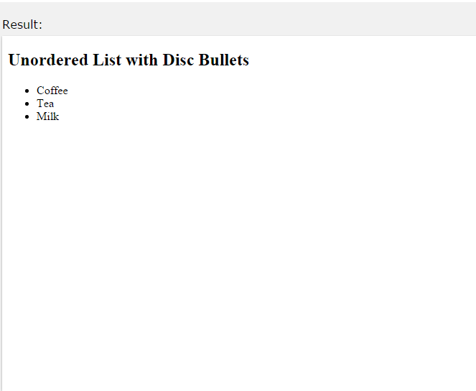
The Style Attribute
Disc:
<ul style="list-style-type:disc">
<li>Coffee</li>
<li>Tea</li>
<li>Milk</li>
</ul>

Slide 15
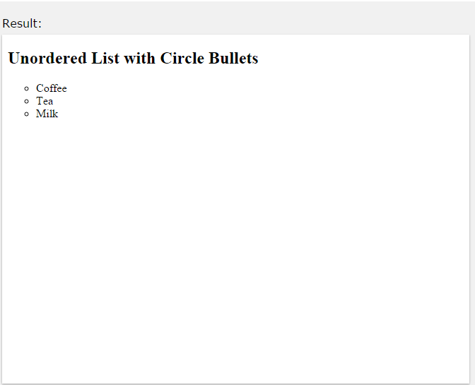
The Style Attribute
Circle:
<ul style="list-style-type:circle">
<li>Coffee</li>
<li>Tea</li>
<li>Milk</li>
</ul>

Slide 16
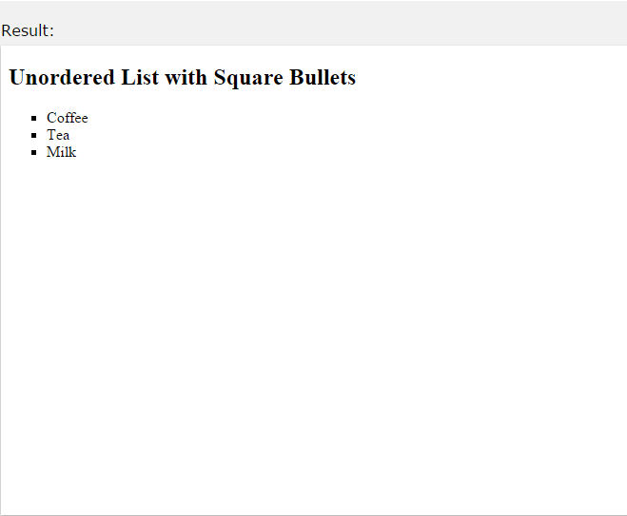
The Style Attribute
Square:
<ul style="list-style-type:square">
<li>Coffee</li>
<li>Tea</li>
<li>Milk</li>
</ul>

Slide 17
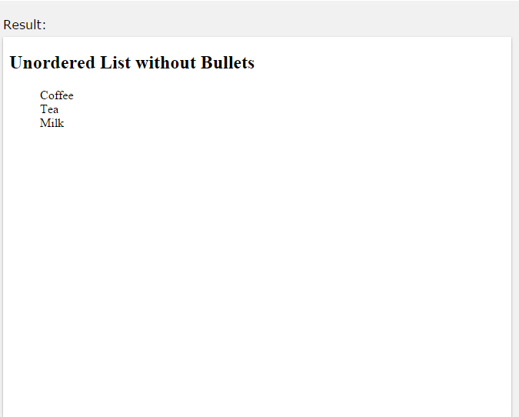
The Style Attribute
None:
<ul style="list-style-type:none">
<li>Coffee</li>
<li>Tea</li>
<li>Milk</li>
</ul>

Slide 18
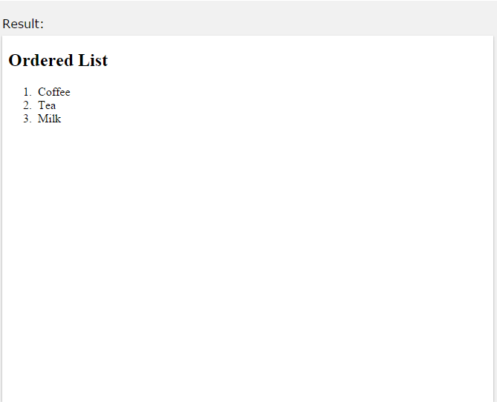
Ordered HTML Lists
An ordered list starts with the <ol> tag. Each list item starts with the <li> tag.
The list items will be marked with numbers: Example
<ol>
<li>Coffee</li>
<li>Tea</li>
<li>Milk</li>
</ol>

Slide 19
The Type Attribute
Type | Description
type="1" | The list items will be numbered with numbers (default)
type="A" | The list items will be numbered with uppercase letters
type="a" | The list items will be numbered with lowercase letters
type="I" | The list items will be numbered with uppercase roman numbers
type="i" | The list items will be numbered with lowercase roman numbers

Slide 20
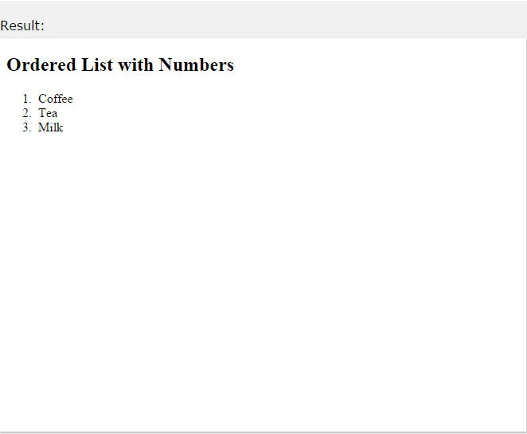
The Type Attribute
Numbers:
<ol type="1">
<li>Coffee</li>
<li>Tea</li>
<li>Milk</li>
</ol>

Slide 21
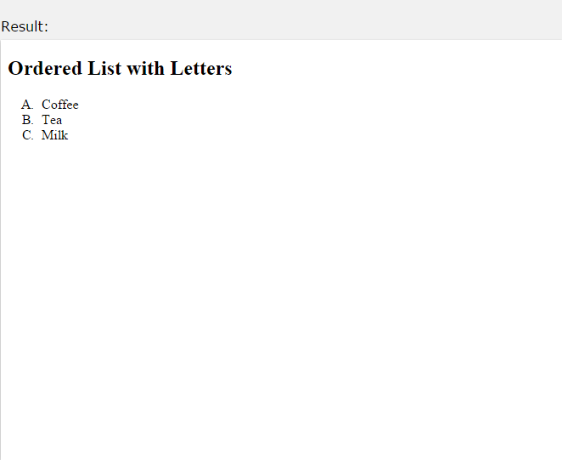
The Type Attribute
Uppercase Letters:
<ol type="A">
<li>Coffee</li>
<li>Tea</li>
<li>Milk</li>
</ol>

Slide 22
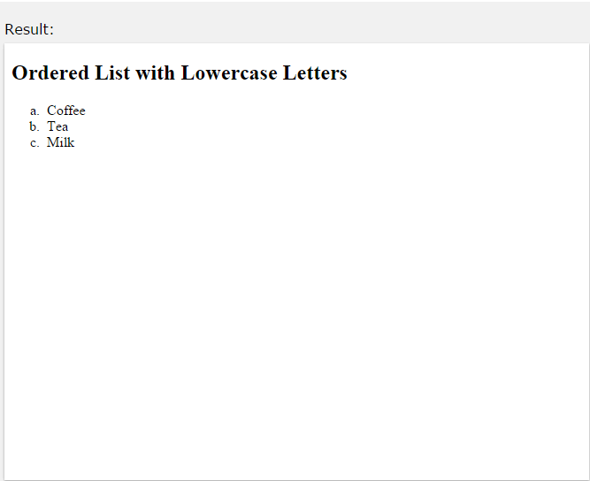
The Type Attribute
Lowercase Letters:
<ol type="a">
<li>Coffee</li>
<li>Tea</li>
<li>Milk</li>
</ol>

Slide 23
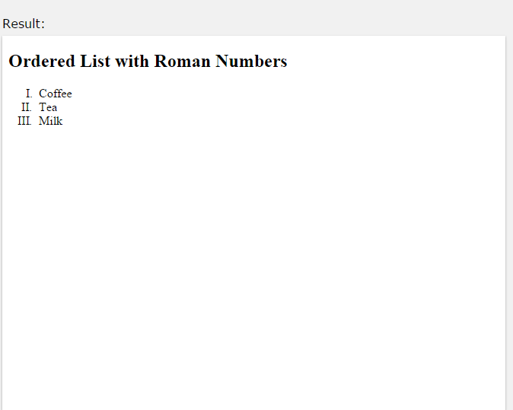
The Type Attribute
Uppercase Roman Numbers:
<ol type="I">
<li>Coffee</li>
<li>Tea</li>
<li>Milk</li>
</ol>

Slide 24
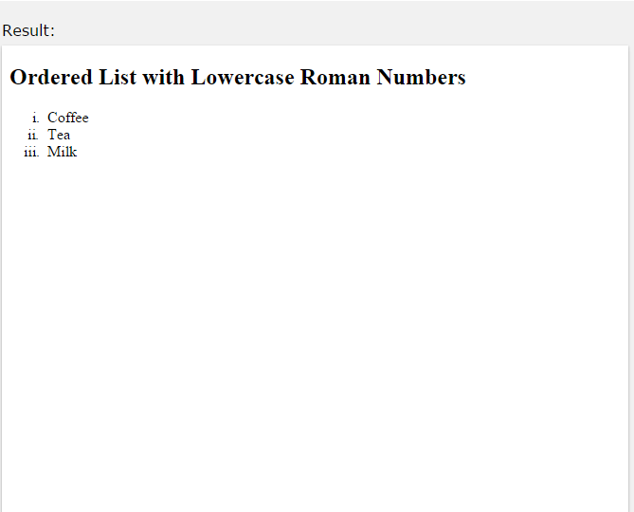
The Type Attribute
Lowercase Roman Numbers:
<ol type="i">
<li>Coffee</li>
<li>Tea</li>
<li>Milk</li>
</ol>

Slide 25
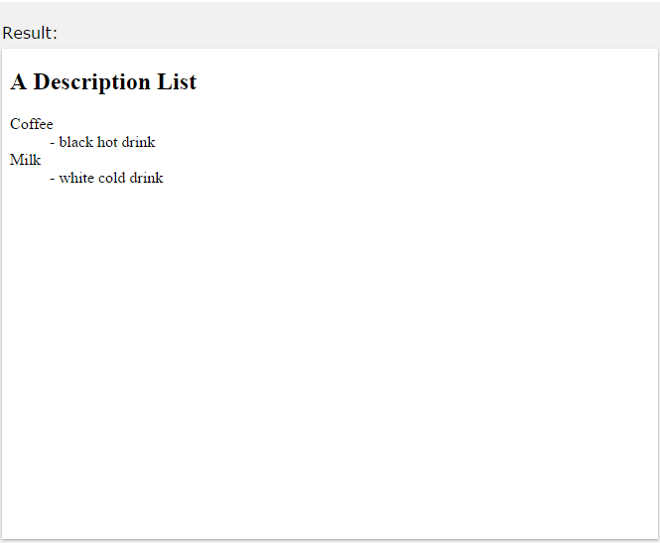
HTML Description Lists
HTML also supports description lists.
A description list is a list of terms, with a description of each term.
The <dl> tag defines the description list, the <dt> tag defines the term (name), and the <dd> tag describes each term:
<dl>
<dt>Coffee</dt>
<dd>- black hot drink</dd>
<dt>Milk</dt>
<dd>- white cold drink</dd>
</dl>

Slide 26
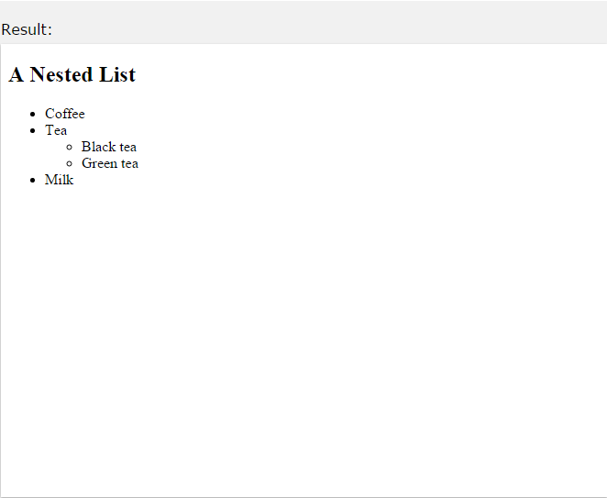
Nested HTML Lists
List can be nested (lists inside lists): Example
<ul>
<li>Coffee</li>
<li>Tea
<ul>
<li>Black tea</li>
<li>Green tea</li>
</ul>
</li>
<li>Milk</li>
</ul>

Slide 27
HTML Color Values
Colors are displayed combining RED, GREEN, and BLUE light. Colors in HTML can be specified by the following methods:
Hexadecimal colors
RGB colors
Color names

Slide 28
Hexadecimal Colors
Hexadecimal color values are supported in all major browsers.
A hexadecimal color is specified with: #RRGGBB, where the RR (red), GG (green) and BB (blue) hexadecimal integers specify the components of the color. All values must be between 00 and FF.
For example, the #0000FF value is rendered as blue, because the blue component is set to its highest value (FF) and the others are set to the lowest value (00).

Slide 29
RGB Colors
RGB color values are supported in all major browsers.
An RGB color value is specified with: rgb(red, green, blue). Each parameter (red, green, and blue) defines the intensity of the color and can be an integer between 0 and 255.
For example, the rgb(0,0,255) value is rendered as blue, because the blue parameter is set to its highest value (255) and the others are set to 0.

Slide 30
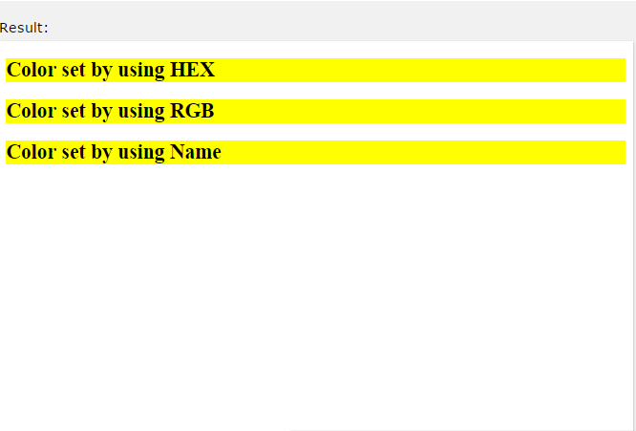
Color Names
All major browsers also support 140 standard color names. Example
Color | Color HEX | Color RGB | Color Name
 | #FF0000 | rgb(255,0,0) | Red
 | #00FF00 | rgb(0,255,0) | Green
 | #0000FF | rgb(0,0,255) | Blue

